Slide 1




Course name: engineering mathematics-iII
B.TECH Second YEAR
Academic YEAR: 2020-2021
Course code : ma 2101
lecture series no : 6
Credits : 3
Mode of delivery : online (Power point presentation)
Faculty : Dr. Pooja Sharma
Email-id : pooja.sharma@jaipur.manipal.edu
PROPOSED DATE OF DELIVERY: 24, 25 August 2020

Slide 2

Session outcome
“Understanding of Lattices and the properties, Understand the concept of different lattices ”

Slide 3
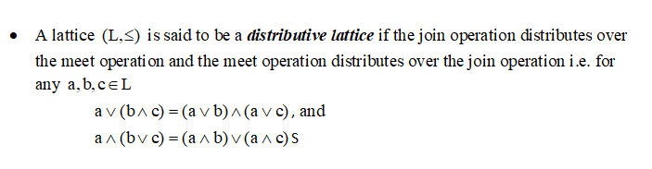
Types of the lattices
A lattice is called complete if every non-empty subset of it has a least upper bound and greatest lower bound. ( Every finite lattice is complete.)
Distributive Lattice

Slide 4
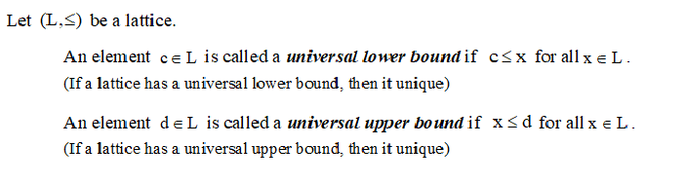

We shall denote the universal lower bound by 0 and the universal upper bound by 1.

Slide 5
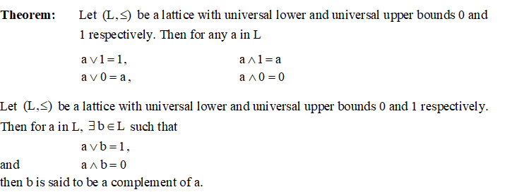

Slide 6
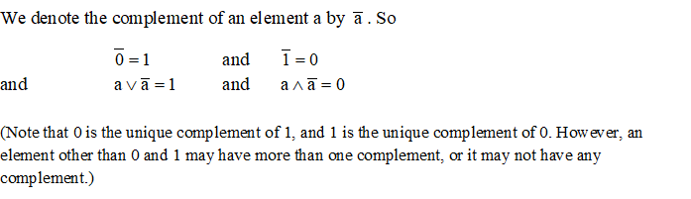
A lattice is said to be bounded lattice if it has both 0 and 1 .

Slide 7
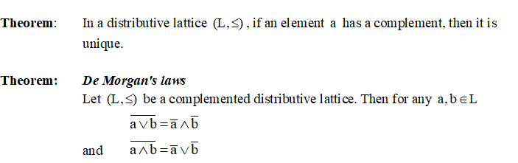

Slide 8
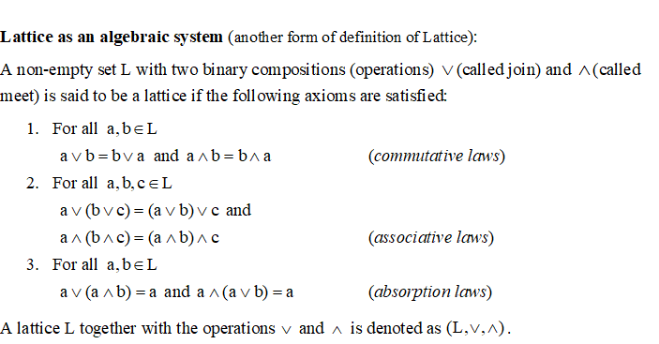

Slide 9
Thanks

